Slide 1
Continuous Assurance
(management)
April 26, 2023
Miklos A. Vasarhelyi
KPMG Distinguished Professor of AIS

Slide 2
THE CARLAB

Slide 3
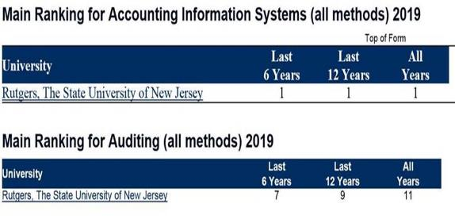
All academic Accounting programs around the world are ranked annually by BYU. For many years now, the Accounting Information Systems (AIS) group at RBS has led the world in the application of information technology to the audit profession. We are very proud to announce that the just-released BYU rankings for 2019 confirm again the continued success of Rutgers Business School in both AIS and audit research:

Slide 4
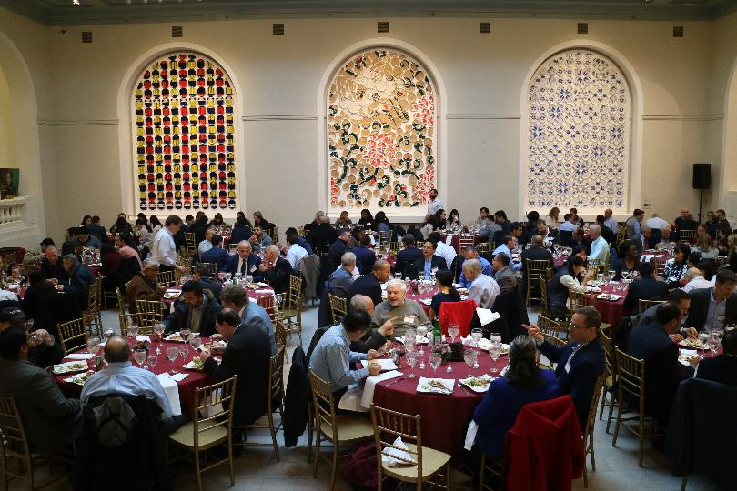

Slide 5
Some new disruptive projects
GASB PIR robots and text mining
NYS OSC tweet and NY City cleanliness
5 CPA firm projects on RPA / IPA (Attended RPA)
What is public Interest? With PIOB
Continuous auditing with intelligent tools (Marinha do Brasil / Hering, State of Santa Catarina)
RADAR – full population testing (MADS), process mining, visual audit
Audit analytics agents (krons and daemons)

Slide 6
SWAM – School of a million courses
Build your own modular course out of tens of lecture-sized modules
Focused (for now) on analytics, IT, and AI
https://www.dropbox.com/sh/txvjxw6rknauwnh/AAD0ds1R9GdSkQ1GhKMeTU9Ra?dl=0
  Link includes SWAM video
  Illustrative module program
  List of some modules

Slide 7
Some SWAM modules
BYOC3: Audit Process Automation | Intro to Audit Automation | https://www.youtube.com/playlist?list=PLtN8FDWFi6eIWg6IJ_2O9Xs2vIbmhVfKh
 | Data Manipulation and Control Flows | https://www.youtube.com/playlist?list=PLtN8FDWFi6eJanESy3wq0Jkr3unRhAm67
 | Data Manipulation, Recordings, Selectors, UI Interactions | https://www.youtube.com/playlist?list=PLtN8FDWFi6eKNg_VS3ZMF9PA5X9qQ6UOQ
 | Automation Techniques | https://www.youtube.com/playlist?list=PLtN8FDWFi6eJ8D_o4JjsQK3PIKZwYyhdQ
 | Billing Automation | https://www.youtube.com/playlist?list=PLtN8FDWFi6eKcuZ2z6ayJMe8rpLyUy5G3
 | Google Mobility Data Analytics | https://www.youtube.com/playlist?list=PLtN8FDWFi6eLLe9rQWBpj_qzhJbAZJ80M
 | Moderate Social Media Using AI | https://drive.google.com/drive/folders/1Y_VdfTc6smIZAusz2CwYcVA0By5Sl_ue
 | Audit Sampling with RPA | https://drive.google.com/drive/folders/1ZpwZTG-CgI6kVzUxd8fPHX7ncL6kaYDy
BYOC4: Blockchain and Crypto currency | Introduction to Blockchain and Smart Contracts | Narrated Slides - https://www.youtube.com/watch?v=4SarGEXwM04&feature=youtu.be
 | Intro to Crypto Currencies | https://youtu.be/NpoUiE_n0vE
 | Crypto Currency Markets and Ecosystem | https://youtu.be/qR6G013nbGo
 | Fair Value Measure of Crypto Currency | https://youtu.be/xTxzR3gxkuo
 | Basics of Cybersecurity | https://rutgers.mediaspace.kaltura.com/embed/secure/iframe/entryId/0_dggzsbvx/uiConfId/12441821 https://rutgers.mediaspace.kaltura.com/embed/secure/iframe/entryId/0_13yg520u/uiConfId/12441821
 | Information Risk Management | https://rutgers.mediaspace.kaltura.com/embed/secure/iframe/entryId/1_qfhyp21n/uiConfId/12441821 https://rutgers.mediaspace.kaltura.com/embed/secure/iframe/entryId/1_68bmdhki/uiConfId/12441821
BYOC5: AI in Audit | Basics of Artificial Intelligence in Accounting and Audit | https://youtube.com/playlist?list=PLauepKFT6DK_IB4QFppiQuglqbGaJxT3A
 | Advanced Artificial Intelligence in Accounting and Audit | https://youtube.com/playlist?list=PLauepKFT6DK-Mmidj9qaZj4Llaa2xIbI7
 | Basics of Clustering for Audit | https://youtube.com/playlist?list=PLauepKFT6DK8w7B0mRNlxeV3O1TzDMJNc
 | Analyses of Exceptions and Anomalies | https://rutgersconnect-my.sharepoint.com/:v:/g/personal/fx25_business_rutgers_edu/ERE6wa2ZYz1KjdZUoe-M-wkBFKyF-0zGRpYKIV05Y1ELPg?e=CZq9Iv
 | Use of Classifiers in Audit | https://youtube.com/playlist?list=PLauepKFT6DK97LLNMPRiP8CNx2fe0APBk
 | Basics of Regression Analyses for Audit | https://youtube.com/playlist?list=PLauepKFT6DK8Fu0Dx-raBsv-lYcPH2Hpr
 | Intro to Audit Automation | https://www.youtube.com/playlist?list=PLtN8FDWFi6eIWg6IJ_2O9Xs2vIbmhVfKh
 | Duplicate Detection Techniques | https://youtu.be/jkWKvk_MU0E

Slide 8
Continuous Assurance
8

Slide 9
An evolving continuous audit framework
Continuous
Audit
Continuous Risk
Monitoring and
Assessment
Automation
Sensoring
ERP
E-Commerce
Continuous
Data
Audit
Continuous
Control
Monitoring
Continuous
Predictive
Audit
Continuous
Intervention
9
9
Notes:
9

Slide 10
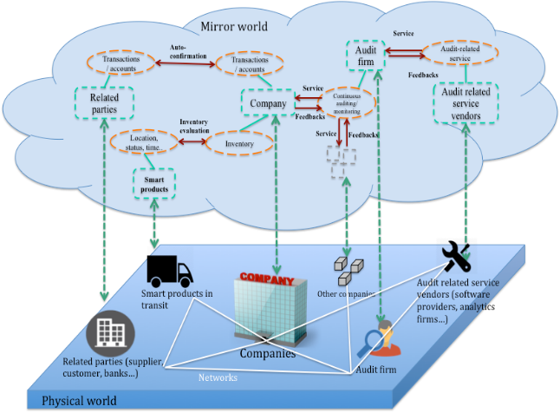
Imagineering Audit 4.0 - Overall

Slide 11
Continuous Data Assurance
--Continuous Process Auditing at AT&T
(1986-1991)
11

Slide 12
Elements
Exogenous Variables
ALERT
Predictions
Metrics
Analytics
Standards
  Process
  Variance
Data base access or loose data access
Exogenous variables (IoT, etc)
AI
Standard of Variance
Measurement
Standard
ERP System
Automatic
Execution

Slide 13
CPAS effort
Audit by exception
This methodology will change
the nature of evidence,
timing,
procedures and
effort involved in audit work.

Slide 14
CPAS OVERVIEW
System
System Operational Reports
Workstation
DF-level 2
Operational
Report
Operational
Report
Operational
Report
DF-level 1
DF-level 1
DF-level 1
Filter
DF-level 0
Alarm
Data Flow Diagrams
Database
Reports
Analytics
Metrics

Slide 15
Continuous Monitoring (1/4)
Unibanco Project
15

Slide 16
Branch Monitoring
16
16
Heuristics for 17 monitoring procedures that monitor about 1400 branches are being re-calculated
Have retained IBM as the “systems integrator” for hardware expansion and systems implementation of continuous audit analytics
Is focusing on transitory accounts
  About 10,000 general ledger accounts
  Unclear how many are transitory
  Range a large number of business units

Slide 17
Unibanco – Some CA Program Features
Automated monitoring of over 5 million customer accounts on a daily basis using 25 automated procedures to:
  Detect errors
  Deter inappropriate events & behaviors
  Reduce or avoid financial losses
  Help assure compliance with existing laws, policies, norms and procedures
Examples of “low hanging fruit:”
  Customer advances
  Excess over credit limit
  Returned checks
  Federal tax payment cancellations
  TED emissions (should this be omissions?)
17
Notes:
We are serving as advisors to review what they do and suggest opportunities for improving existing procedures and expanding procedures to cover other high-risk areas. Key risks are monitored daily
The process entails follow-up of alarms, reporting to higher level echelons, changing the parameters of the monitoring (for what purpose?) and collaborating with the fraud and risk management initiatives inside of the organization when necessary
Planning a substantial expansion of scope of the effort (to achieve what?)
CA included in the performance objectives of IA management
They are planning to progress towards some areas like the usage of continuity equations (advanced analytics) and control monitoring

Slide 18
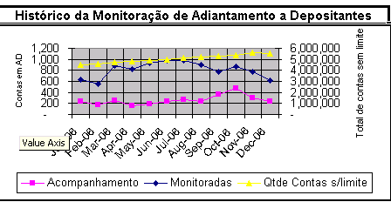
Unibanco – Advances to Clients Monitoring
18
Notes:
An example of the output of one CA procedure that monitors 5.5 million accounts for inappropriate advances to clients
About 1000 accounts flagged per month
About 200-400 accounts with unjustified “above the limit” drafts, on average, per (what time period)

Slide 19
Continuous Monitoring (2/4)
Continuous Monitoring with Interactive Data Visualization and Machine Learning:
An Application to Healthcare Payroll Process
CPA Australia, CAR Lab
19

Slide 20
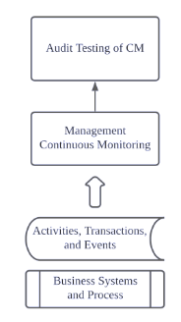
Contribution
  The designed CM artifact is proactive and intelligent with technologies like interactive data visualization, dashboard, and machine learning anomaly detection algorithms.
  We provide real-world evidence on the effectiveness & efficiency of designed artifact with the payroll process of a healthcare institution.
The payroll system of our partner hospital is very representative of the unique challenges healthcare payroll systems face.
  Payroll expenses account for 70% of its total operating costs
  FY 2019 includes the challenging times of the COVID-19 pandemic.
  The Hospital has over 10,000 employees across multiple professions and disciplines, with high staff turnover, high costs of allowances for filling vacant shifts, overtime, paid leave, and holidays.
  The artifact and design framework provide a valuable guidance for practitioners to follow. The year-end external audit can benefit from the adoption of CM artifact.
Notes:
Our research contributes to the literature and the practice in several important ways.
As a continuation of professor miklos’s intro of FPT, this Experimental project applying contemporary visualization and machine leaning techniques
early phase, preliminary result
Gernal purpose: Compare components, complements
Supervies vs unsu
What are we doing
Sample testing deficiency: eliminating sampling risk
Complement the sampling risk examining 100 percent of the transactions
Why is important
by providing audit evidence on a larger and more complete scale
research partner

Slide 21
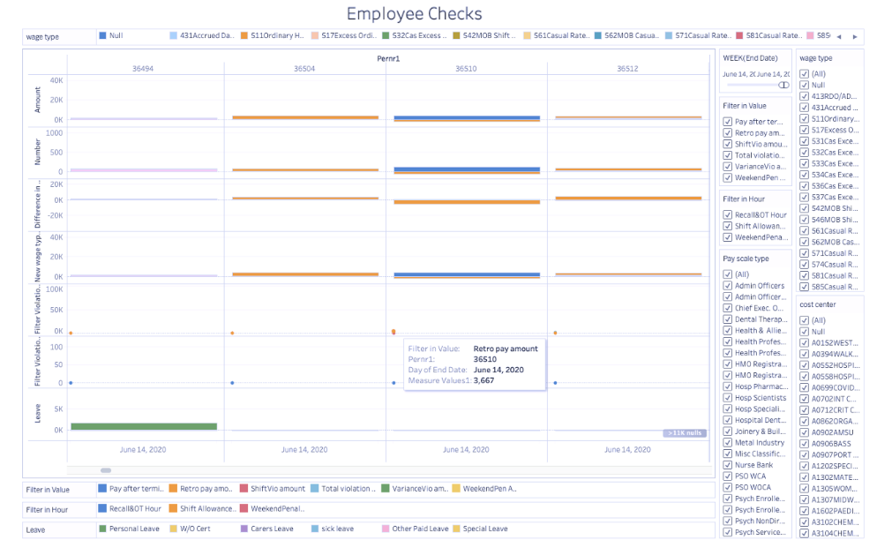
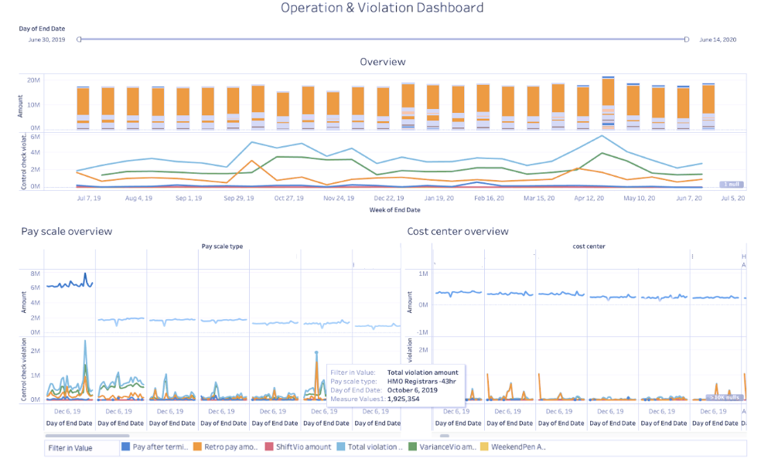
Stage 3: CM model development
  Risk reassessment with operation & violation dashboard
    Purpose: For management to gain in-depth knowledge on corporate operative situations and control weaknesses
    Tool: Tableau (Anoshin et al., 2019), a user-friendly GUI-based interactive visualization tool
    Steps: Setup dashboard, import ERP system data, display summaries of business process performance index and control check violations. Create sorting, filtering, and drilling down features.
  Anomaly detection dashboard for notable item identification
    Purpose: Provide a working platform for anomaly inspection
    Tool: Tableau
    Steps: Display control check violations on an individual level.
Notes:
As a continuation of professor miklos’s intro of FPT, this Experimental project applying contemporary visualization and machine leaning techniques
early phase, preliminary result
Gernal purpose: Compare components, complements
Supervies vs unsu
What are we doing
Sample testing deficiency: eliminating sampling risk
Complement the sampling risk examining 100 percent of the transactions
Why is important
by providing audit evidence on a larger and more complete scale
research partner

Slide 22
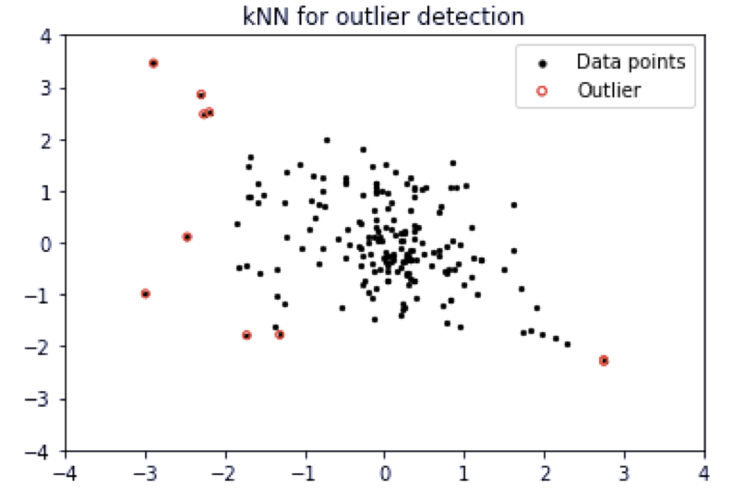
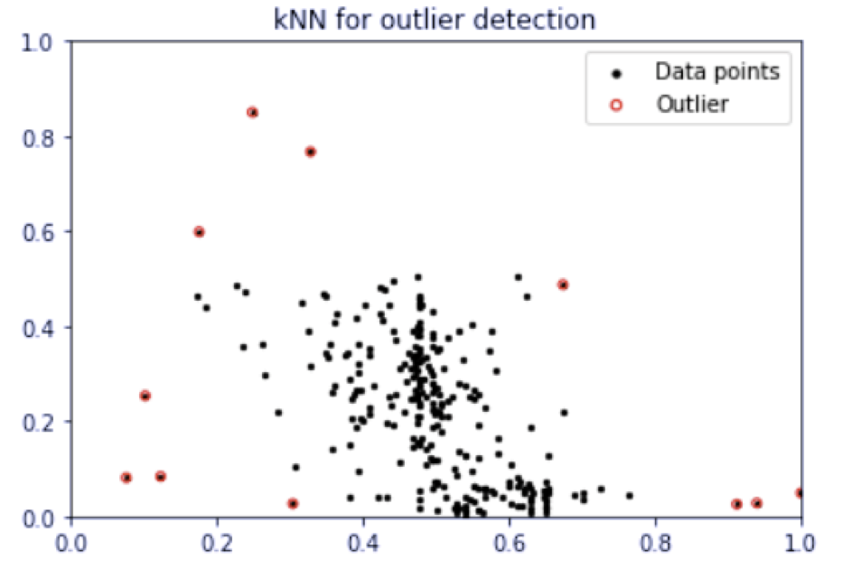
Second-phase Anomaly Detection
Purpose
  Detect extreme payment and other pay ratio
Anomaly detection algorithm
  K-NN Clustering:
    A type of proximity-based unsupervised machine learning technique
    Attribute engineering, Objective: Avoid handcrafted cluster center
    Lower contamination rate for Auto-encoder
Outlier detection for employees in major cost centers
Outlier detection for scattered employees
Normaized basic pay amount
Absolute basic pay amount
Normalized other pay ratio
Absolute other pay ratio
Notes:
Another way is … without filtering
Apply advanced machine learning algorithm
Label x, y
explaination
Advantage & Disadvantage
Underlying pattern
Require to ensure comparability and low contamination rate
interpretability
Audit judgement is limited to parameter choosing

Slide 23
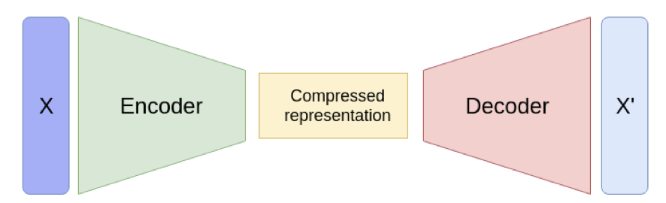
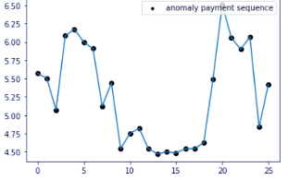
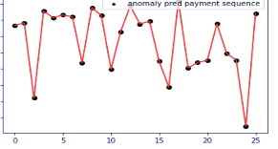
Second-phase Anomaly Detection
Anomaly detection algorithm
  Purpose:
    Detect abnormal payment series
  Auto-encoder:
    A type of neural network: tune hyperparameters to recreate input payment sequence
    Anomalies are the ones with the most recreation loss
    Next step: Laten generative process for more interpretation
The structure of Auto-encoder
Original sequence
Model-generated sequence
An example of anomaly
A constant low-level of payment before COVID is not typical
payment
Pay cycle
Pay cycle
Notes:
Another way is … without filtering
Apply advanced machine learning algorithm
Label x, y
explaination
Advantage & Disadvantage
Underlying pattern
Require to ensure comparability and low contamination rate
interpretability
Audit judgement is limited to parameter choosing

Slide 24

Real-time CM dashboard
Input: a live connection from company database to Tableau data source
  (https://help.tableau.com/current/guides/everybody-install/en-us/everybody_admin_data.htm)
  Refresh worksheet with new data extraction periodically (higher performance)
  Real live connection (data freshness, data privacy, decision making)
Output: Tableau analytics dashboard/result real-time sharing
Notes:
As a continuation of professor miklos’s intro of FPT, this Experimental project applying contemporary visualization and machine leaning techniques
early phase, preliminary result
Gernal purpose: Compare components, complements
Supervies vs unsu
What are we doing
Sample testing deficiency: eliminating sampling risk
Complement the sampling risk examining 100 percent of the transactions
Why is important
by providing audit evidence on a larger and more complete scale
research partner

Slide 25
Continuous Monitoring (3/4)
RADAR
Full population testing (MADS) and process mining
AICPA, CAR Lab
25

Slide 26
THE RADAR (Rutgers Aicpa data analytics Research) project
Full Population Testing
Process Mining
Visual Audit

Slide 27

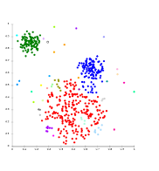


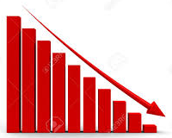
MADS ANALYTIC FRAMEWORK
MADS Model Build Process
Whole Transaction Data
(Entire Population)
Exception Filtering - Python
Risk factors for completeness, occurrence and accuracy
(e.g., Cutoff test, Unusual trends and adjustments, Duplicates, Irregular salary structure, Recompute gross pay and accounting ledgers)
Step 1:
Filters for Significant Potential Risk Factors
Step 1 Outputs
    Data Analytics
    Outlier Detection Techniques
    (e.g., Unsupervised Machine Learning Clustering - Weka)
    Visualization Techniques
    (e.g., Dashboard - Tableau)
Step 2:
Data Analytic Techniques
Step 2 Outputs
Step 3:
Prioritization
    Prioritization
    A flexible weighting scheme
    (e.g., suspicion function)
Prioritized
Notable Items

Slide 28
Continuous Control Monitoring (3/4)
(CCM)
SIMENS Project
CAR Lab
28

Slide 29
Siemens projects
29
29
Focused on audit automation
  First project looked at automating CCM in SAP
  Second project focused on a wider scope of automation
  A third project would think about reengineering the audit action sheets
  The fourth project aims at formalizing SOD, activities, and control structures

Slide 30
Siemens Pilot Leverages Audit Action Sheets Of External Auditor KPMG
Key success enabler for pilot is the ability to use AASs provided by KPMG (Germany)
Provides template for CA analytics: no need to reinvent the wheel, immediate buy in from relevant parties, satisfies external auditor.
400+ AASs: need to determine which ones can be CA-enabled.
AASs included a mixture of tasks some of which could only be accomplished by a human, such as.
  Interviewing the client about their reconciliation procedures
While some others involved well-scripted interactions with the client’s enterprise system such as:
  Execute a certain SAP R/3 transaction and/or report and verify that its result is as specified.

Slide 31
Pilot CMBPC System Implemented At Siemens

Slide 32
Re-engineering internal control evaluation
CAR Lab
32

Slide 33
Overview of the project
Develop a Predictive Analytical Approach – Leveraging emerging technologies to anticipate control failures, including identifying missing controls and redundancies
Determine how emerging technologies can improve the quality of the audit and performance of the auditor
Operationalize specific techniques to provide more informative risk assessments
Improve the internal control testing process
Usage of emerging technology:
    Improve the quality of the risk assessment
    Systematically evaluate controls
    Reduce manual control testing (i.e., reduce time & labor)
    Examine a broader amount of transactions
    Enhance the quality of the information given to management

Slide 34
Machine Learning
Anomaly Detection
  Which of these transactions do not follow the happy path?
Classification
  Will this payment be late?
Regression
  How many days delay of this payment?
Clustering
  Which of the noted exceptions have similar flows?
Association Rule Learning
  If the purchase order is signed by X, which activity is also likely to happen?
Ranking
  Prioritize the noted variants

Slide 35
“Happy” Path Identification
Variants Identification

Slide 36
Process mining
Mieke Jens (Hasselt University)
Michael Alles (Rutgers Univ.)
Miklos A Vasarhelyi (Rutgers University)

Slide 37
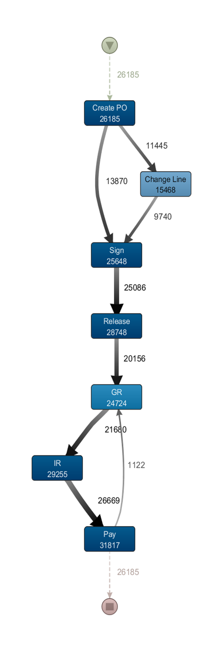
Fuzzy miner output

Slide 38
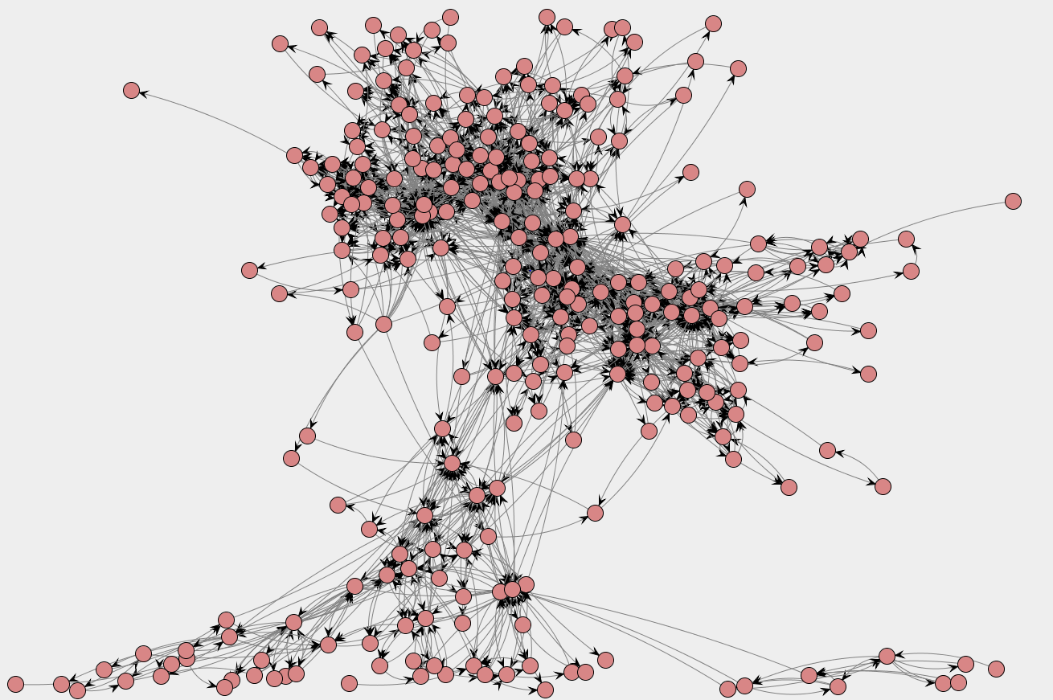
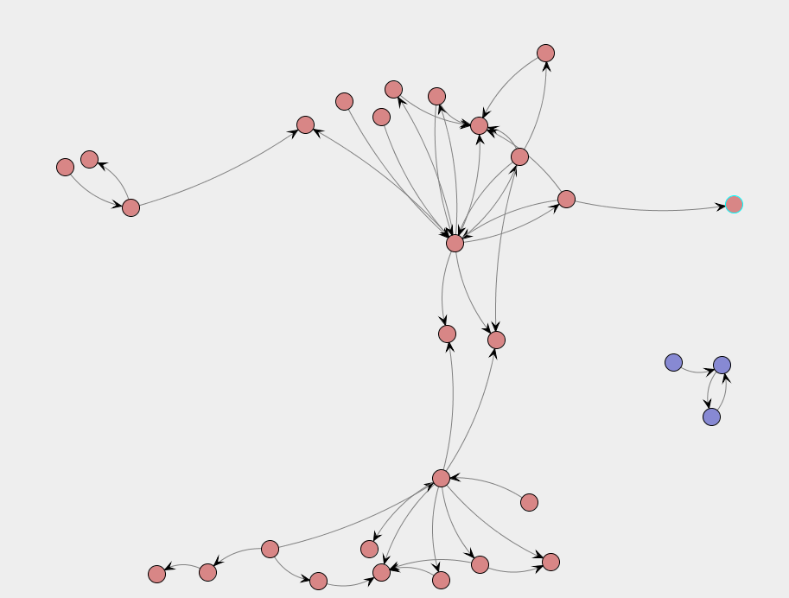
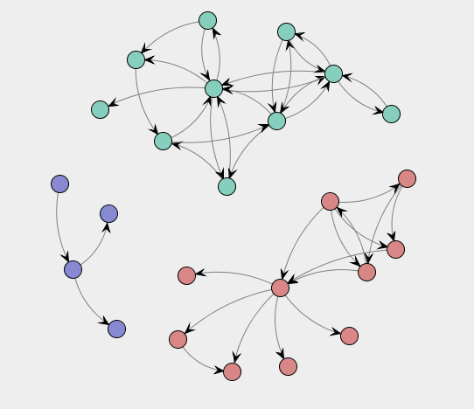
Social Network of all originators in the procurement process

Slide 39
The Audit Ecosystem: Integrating Artificial Intelligence and Expert systems in the audit domain
Miklos A. Vasarhelyi
Rutgers University

Slide 40
“Fruit Salad”
RPA
Exogenous Data
Anomaly detection
Controls
and
Control Structures
Process Mining
AI
Statistical Analytic Method
Visualization
Continuity Equations

Slide 41
Cloud points of entry
Duplicate
Detection
agent
Manual entry flag
Split transaction
agent
Krons & Daemons’Single function (agents)
Cooperating agent (discriminant
Function)
Population integrity
agent
Activity
Monitoring
Exception
Selection
methods
Auditor
Exception evaluation
Cloud points of exit
Assurance
Ecosystem
Processes
Credit sale
sale
Production
Collect
cash
delivery
treasury

Slide 42
Multidimensional Clustering for audit fault detection
Sutapat Thiprungsri
Miklos A. Vasarhelyi

Slide 43
Metlife
Insurance monitoring and
assessment
Wire transfers
43
43
Data stream of over 200K wire transfers
Data only currently available for the wires and the records possess little information
Little context knowledge of the major feeding streams
No fraud training data available
Worked during the audit supplementing the audit team work
Developed a series of data filters relating to specific conditions and trends
Working on an aggregate weighting model
Need in the field verification of picked data

Slide 44
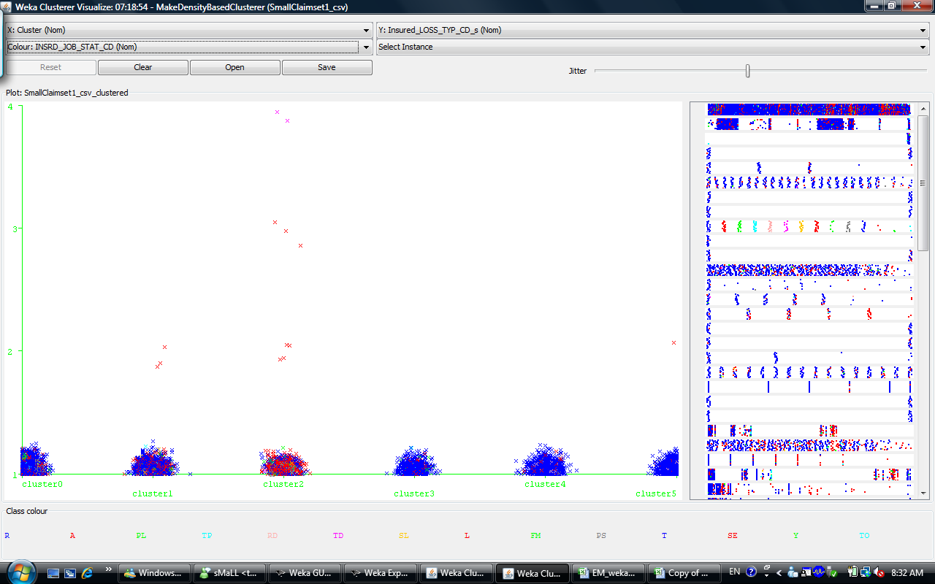
Analyzing individual variables, we will be able to see clearly that some claims have rare values
Notes:
44

Slide 45
Applying outlier detection in Accounting and Auditing
Rutgers University
CarLab

Slide 46
Artificial Intelligence
Machine Learning
Unsupervised Learning
Outlier Detection

Slide 47
Outlier Detection
“An outlier is an observation which deviates so much from the other observations as to arouse suspicions that it was generated by a different mechanism (Hawkins 1980).”
semantically close to audit terminology such as audit exceptions and transaction anomalies
An outlier often contains useful information about abnormal characteristics of the systems and entities:
  Abnormal debit/credit amount, occurrence time, counterparty, etc.
  Possible reasons: mechanical faults, changes in system behavior, fraudulent behavior, human error etc.
Ten popular outlier detection algorithms:

Slide 48
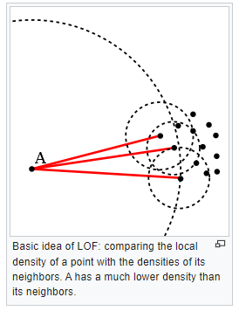
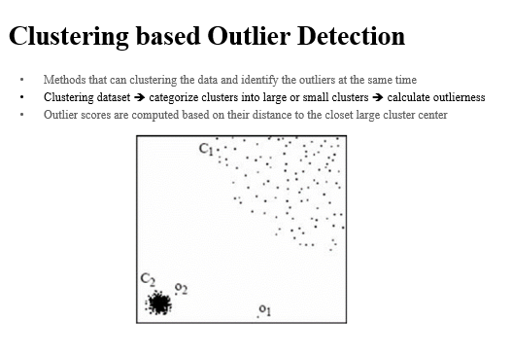
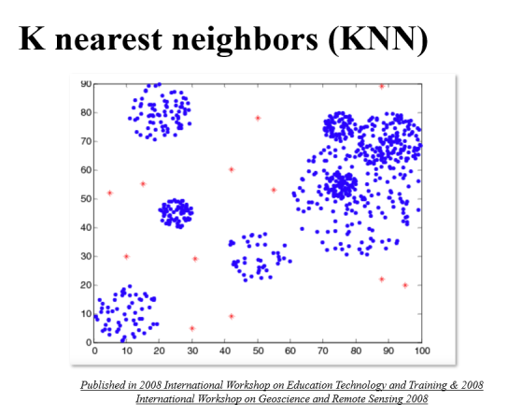
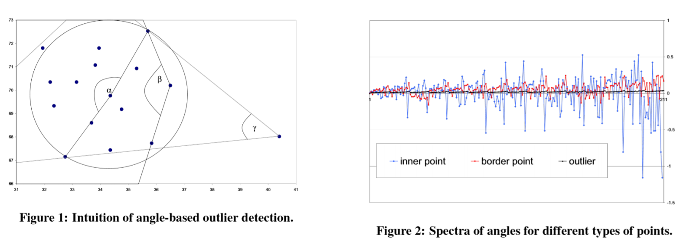

Slide 49
Outlier detection research process: will it change auditing?
AICPA DAS / caseware AI
Literature review / identification of Apps/ testing in public dataset
Testing with two client’s data in Holland
Large discrepancies in results with different methods
Experimentation with public datasets (10)
Searching for preferential method usage guidance and resolution of discrepancies methodology
Testing in real engagements

Slide 50
Continuous Monitoring Application in Tax Field
(currently in China)
50

Slide 51
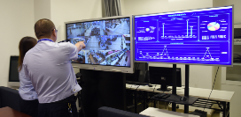
Tax Command center
Tax Service Hall
Tax Service Hall
Tax Service Hall
Tax Service Hall
Commend center ➔ Data analytics
Risk Alert
Real time dispatch
Service quality management
Notes:
http://hebei.chinatax.gov.cn/hbsw/ssxc/zyxw/202112/t20211228_3013066.html
http://gk.chengdu.gov.cn/govInfoPub/detail.action?id=2435381&tn=2

Slide 52
Internal information:
CTAIS 3.0
Big data platform
Electronic Tax Bureau
Other departments:
Bank
Social security
Other information source：
Web Scraping
News
Information Source
Data Pool
Risk Portrait
Taxpayer
Consecutive loss
Tax type
Tax rate
Industry
Event
Risk identify and response
Monitor & Predict
Notes:
https://m.gmw.cn/baijia/2020-09/30/1301622884.html

Slide 53
PG

Slide 54
P&G (work with the audit innovation team)
KPI projects
Automating order to cash
Vendor files / duplicate payments
IA Engagements & control self-assessment
P-Card Expert System

Slide 55
Example of analyzing exogenous data
New York city street cleanliness:
apply text mining techniques to social media information
Huijue Kelly Duan¹
Mauricio Codesso²
Zamil Alzamil³
¹Rutgers, the State University of New Jersey
²Northeastern University
³Majmaah University

Slide 57
Continuous Intelligent Pandemic Monitoring （CIPM)
Huijue Kelly Duan
Hanxin Hu
Miklos Vasarhelyi
Accounting Information System
Rutgers, the State University of New Jersey

Slide 58
Research Objectives
Use measurement science (accounting), assurance science (auditing) to examine the situation
Establish a continuous monitoring system (CIPM)
  assess the realistic parameters, and continuously monitor the evolution of COVID-19 by using exogenous variables
  generate alerts following risk assessments from the time series, machine learning models, and cross-sectional analytics
  validate the epidemic related numbers and to provide guidance to policymakers so that sufficient resources can be allocated to the upcoming high risky areas in order to control the spread and lower the impact of the disease

Slide 59
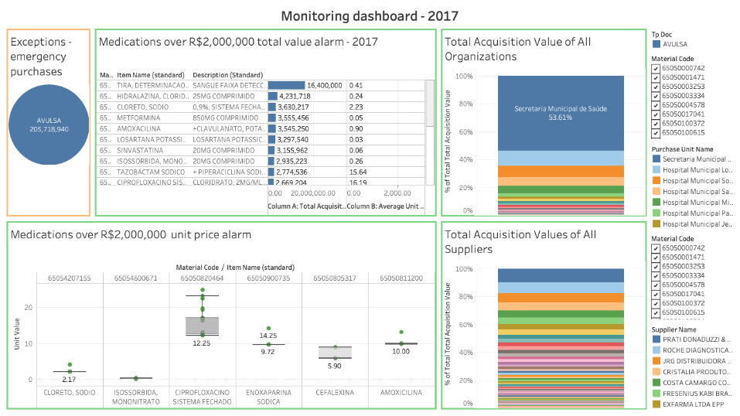
Continuous Monitoring Dashboard
Notes:
Final product where auditors could view all the generated alarms and trace back to the suspicious procurement records
That means, that internal audit team could use the continuous monitoring dashboard to monitor the daily or monthly data and investigate these suspicious records.
Again, Here we use the yearly data to demonstrate the methodology, but auditors that adopt this methodology could process the monthly data or daily data in the same way

Slide 60
Continuous Risk Monitoring and Assessment
Assurance on Risk Management

Slide 61
Key Risk Indicator (KRI)
KRI provides early warning systems to track the level of risk in the organization
KRI can be identified through analysis of key business activities
  6 steps for KRI identification (Scandizzo, 2005)
Well identified and computed KRIs provide a reliable basis for computing the riskiness of firm for specific risk, such operational risk, liquidity risk, as well as the overall riskiness of firm.
  f(KRI(i),KRI(ii),…KRI(n))= Risk exposure
  External risk factors may be mapped manually into the computation of KRIs and risk exposure.

Slide 62
Process risks
Environmental
risks
Black
Swans
KRIs
Variable selection algorithms (heuristics expert based)
Risk minimization / audit return maximization algorithms
Audit
Procs.
Re-arranged

Slide 63
Key Risk Indicator (KRI)
KRI provides early warning systems to track the level of risk in the organization
KRI can be identified through analysis of key business activities
  6 steps for KRI identification (Scandizzo, 2005)
Well identified and computed KRIs provide a reliable basis for computing the riskiness of firm for specific risk, such operational risk, liquidity risk, as well as the overall riskiness of firm.
  f(KRI(i),KRI(ii),…KRI(n))= Risk exposure
  External risk factors may be mapped manually into the computation of KRIs and risk exposure.

Slide 64
Modeling and filtering- the preventive audit

Slide 65
Combining forensic analysis, forensic experience and real time technology
Patterns detected/ examined in forensic analysis can / should be used in CA/CM filtering
If faults are searched/found in forensic examination they can be impounded in process filtering, exception reporting, and audit by exception
If faults are not found it does not mean that they do not or will not exist

Slide 66
Incorporating Forensics into an CA/CM philosophy
Operations
archives
Forensic
models
Forensic
models
controls
Forensic
analysis
Filtering by
Forensic
models
Audit
By
Exception

Slide 67
Predictive Audit: Transaction Status Prediction

Slide 68
Predictive Audit
A predictive audit could help auditors and management to block a problem before it spreads.
It is better to look forward than just look back at the historical information
Continuous audit is used to monitor present transactions
Can we use CA to predict the future?
  Audit by exception
  Alarm and warning system
Notes:
A predictive audit could help auditors and management to block a problem before it spreads.
Correctly understand the data and be able to analyze them properly would uncover interesting pattern, trend, weakness or irregularity of data and processes.
Audit by exception allows auditors to plan and execute audit work based on internal control evaluation, and to focus more on specific areas that need attention. The alarm and warning system could be implemented in any business process to assist auditors and management in monitoring the systems. This paper illustrates the application of this feature.

Slide 69
Transaction status prediction
Revenue cycle is a high risk area.
  Channel stuffing
This study aims to predict future sales cancellations, an indicator of a suspicious transaction.
If there is any suspicious transaction, the system should have a warning or an alarm report.
What prediction model(s) will more accurately forecast business transaction outcomes?

Slide 70
Results and analysis
Models comparison of cost-sensitive approach
1:14 ratio 1:16 ratio
Model/ Measurements | Accuracy | False negative rate | False positive rate
J48 | 0.64 | 0.48 | 0.35
Logistic regression | 0.70 | 0.50 | 0.28
Support vector machine | 0.79 | 0.63 | 0.18
Accuracy | False negative rate | False positive rate
0.53 | 0.36 | 0.48
0.57 | 0.39 | 0.44
0.73 | 0.56 | 0.25
Notes:
Accuracy = (TP + TN) / N
Specificity = True negative rate (how many % of cancellation transactions that the model can correctly predict as cancelled.)
Recall = the proportion of Real Positive cases that are correctly Predicted Positive. (how many % of non -cancellation transactions that the model can correctly predict as non-cancel.)
Precision = the proportion of Predicted Positive cases that are correctly Positives. (TP/ (TP+FP))
False alarm rate = focus on FP (predict cancel as non-cancel)

Slide 71
Conclusion
Predictive audit lets auditors monitor and audit controls in a preventive basis.
The result of prediction model could alert auditors for suspicious transactions.

Slide 72
Continuous Intervention
Assurance on Risk Management

Slide 73
Continuous intervention
Automatic error correction in selected cases
Filtering downstream transmission, transaction interruption upon high suspicion score
Filtering potential future problematic effects based on prediction
Is this auditing?
Is this management?
Is this accounting

Slide 74
Evolving towards the future
74

Slide 75
Next 5 years
Integrating small AI-ish function in the processes e.g. vision, text analytics, counting, 2nd level automation (RPA)
Creating Control system measurement and monitoring schemata (control dashboard)
Creating ML-Based standards for Business Process Monitoring and Alarming (to be able to detect variance)
Exclude not time sensitive variables (e.g. depreciation, airport fees, owners equity, intangibles, etc)
Creation of alternative real-time audit reports for different compliance masters
75

Slide 76
Next 10 years
Incorporating Exogenous Variables
Enhancing the audit data standard
Changing audit processes and standards
Moving towards predictive audits
Automating wherever you can (RPA/ IPA/ AA)
Improve and develop intelligent analytics
Developing
  Process mining
  Automatic confirmations
  Blockchain based shared applications with articulated smart contracts

Slide 77
Thanks!!
Contact us at
miklosv@rutgers.edu
Visit
http://raw.rutgers.edu

